Slide 1
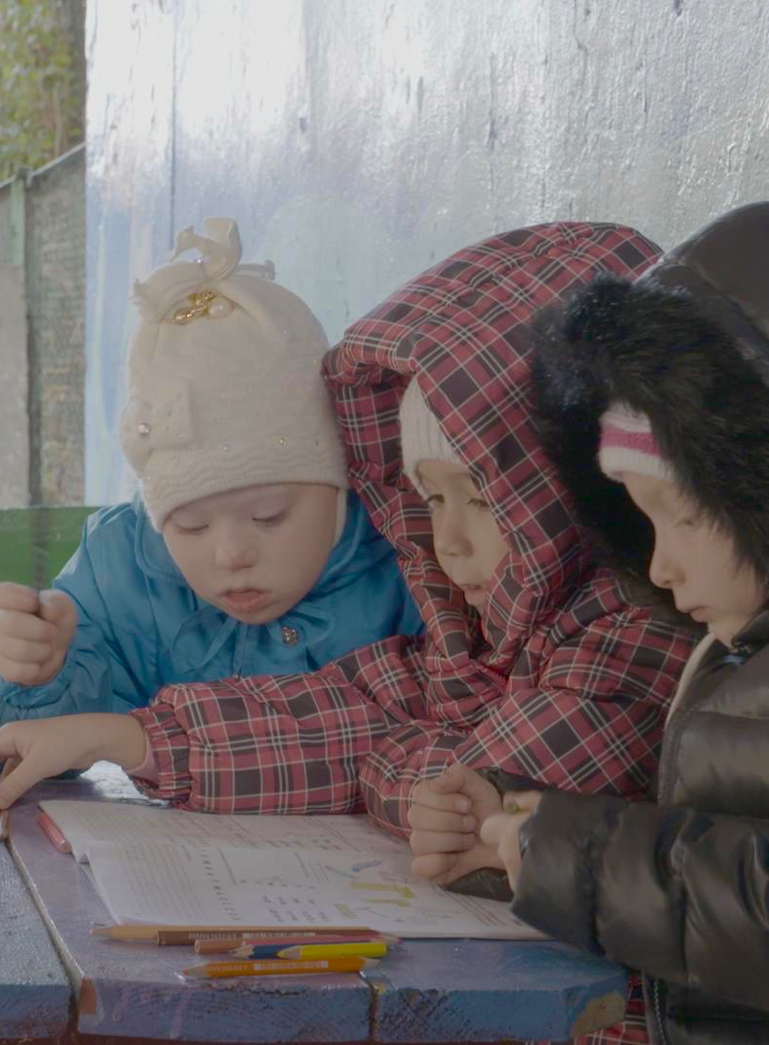
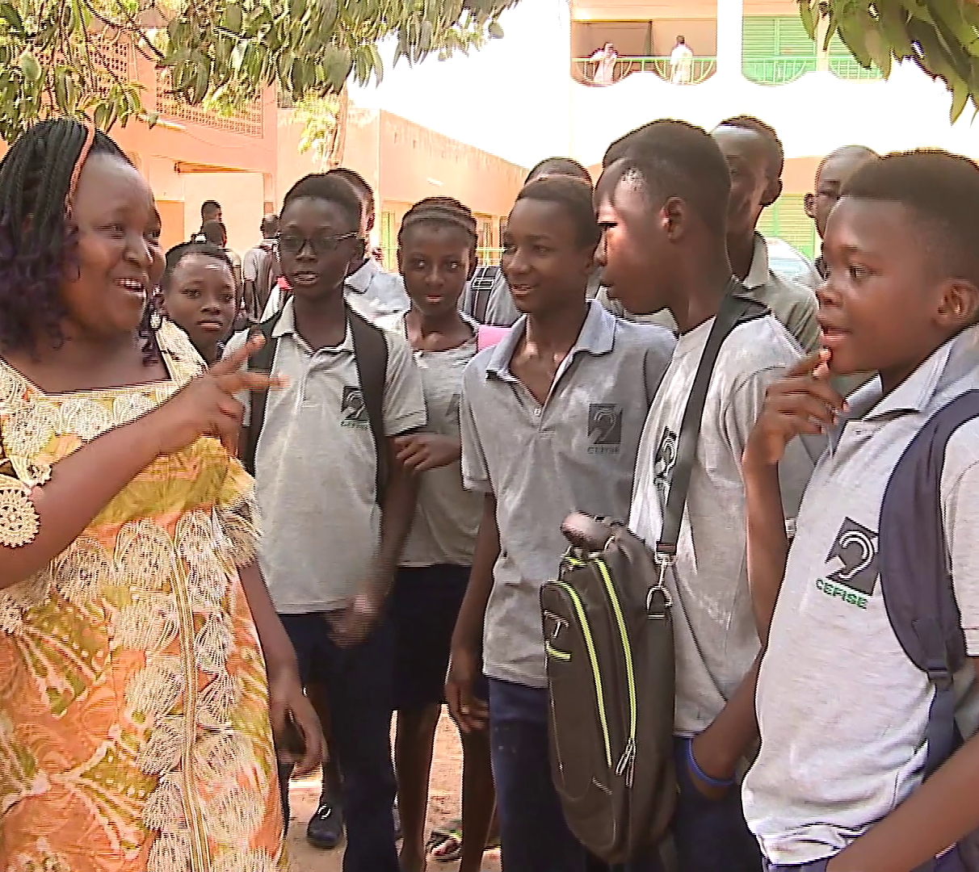
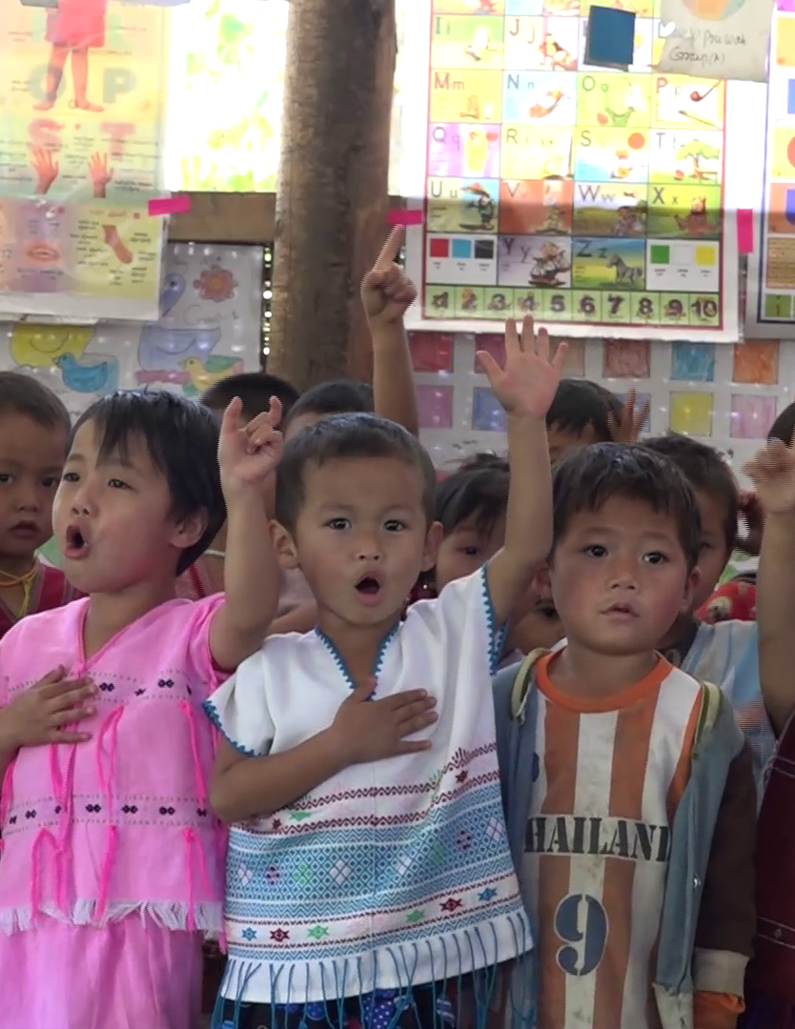
“An Inclusive Day: Building foundations for learner-centred, inclusive education”
A video-based training resource for teachers

Slide 2
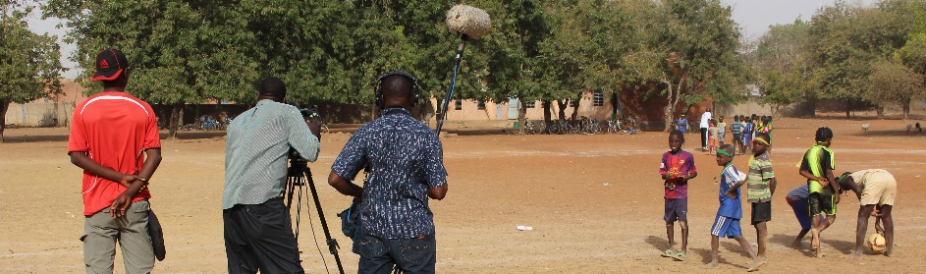
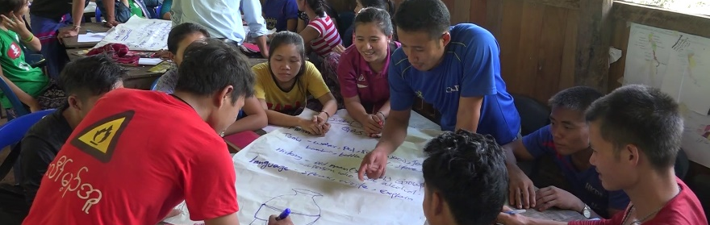
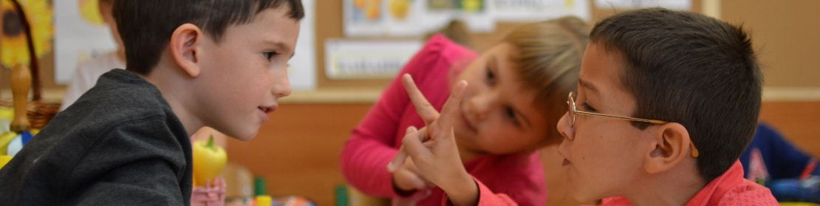
What is this resource?
This resource contains 10 short videos, plus guidance manuals for trainers.
The videos show some of the ways in which learners can be included or excluded during a typical school day, and provide ideas for simple steps teachers can take to improve inclusion.
The manuals provide trainers with lots of ideas for workshop activities to help teachers build the skills and confidence to become more inclusive and less exclusive.

Slide 3
What is different about this resource?
There are lots of training manuals on inclusive education. Many are good quality but very theoretical.
There are also lots of videos available online about inclusive education. Many feature project promotion and fundraising messages, rather than practical teacher training, or discuss inclusive education in wealthy countries.
  EENET’s video-based training resource fills an important gap, offering a more practical and real-life view of inclusive education in resource-limited contexts.

Slide 4
What is different about this resource?
The structure of EENET’s resource is different. Many trainings follow a fixed formula: first discussing concepts and definitions, then the legal basis for inclusive education, and then the ways to implement it.
  EENET’s training resource has a different format. The content of our training follows the timeline of ‘a typical day’: what happens before school and the journey to school, what happens at school and after school. Within this timeline the resource covers essential concepts, policy issues and practical implementation ideas – but in an engaging and real-life format.

Slide 5
What topics does the resource cover?
Before school – this looks at factors at home that impact on children’s attendance or participation in school, such as whether they do chores or eat breakfast. It suggests simple actions that teachers can take.
Getting to school – this looks at the journey to school, the ways in which this can cause exclusion, and ideas for how to address this.
Arriving at school – this looks at how schools make children feel welcome or unwelcome, and what teachers can do to improve this.

Slide 6
What topics does the resource cover?
Preparing lessons – this looks at simple steps teachers can take to ensure they prepare well so that all learners join in and learn.
Improving the learning environment – this looks at simple, low- or no-cost steps teachers can take to improve the accessibility and comfort of the classroom and school environment.
Understanding learners and their needs – this looks at how teachers can find out more about their learners and what they are good at or need help with.

Slide 7
What topics does the resource cover?
Teaching and learning – this looks at simple approaches teachers can use in the classroom to make their lessons more learner-centred and inclusive.
Break times – this looks at periods when learners are not in class, which can still impact on their presence, participation and achievement in school.

Slide 8
What topics does the resource cover?
Sport and exercise – this looks at how these non-academic activities can help learners feel included and help with academic learning.
After school/homework – this looks at the controversial issue of homework, which can be problematic for many learners, and how to ensure that homework does not lead to exclusion for any learners.

Slide 9
Who can use the resource?
The training package can be used by trainers as part of a structured training course for teachers and other educators.
The videos can also be used by individual teachers for self-study.

Slide 10
What languages are available?
The subtitles for the videos are already available in many languages, including:
Arabic
English
French
Portuguese
Russian
Spanish
Swahili
The manuals are currently available in English, French and Portuguese.

Slide 11
How long does the training take?
The resource can be used very flexibly by the trainer, depending on the time available and the existing skills, experiences and needs of the trainees.
If the trainer uses all or most of the activities, then each module might take one day, meaning you will need 10 days for the full training.
However, it is easy to select activities to create trainings that last any length of time, from half a day upwards.
From experience, we recommend that you provide teachers with longer-term training. Short, one-off trainings are rarely sufficient.

Slide 12
How complex is the training?
The resource is designed to allow trainers to offer very simple trainings, or more detailed and complex sessions, depending on the trainees’ needs and experiences.
Each module is divided into three types of sessions:
  Basic activities – all trainees may need to do these, especially if they do not already have much experience of inclusive education.
  Important theoretical issues to discuss – the trainer can decide if trainees need to know more about inclusive education theory and concepts.
  Digging deeper into specific issues – these activities give trainees a chance to look at specific inclusion topics in more detail.

Slide 13
What types of activities are involved?
Each manual suggests a wide range of participatory workshop activities, including:
  Group, pair and individual work
  Written and verbal activities
  Games, drawing, photo and performance activities.
There is a focus on encouraging participants to critically reflect on their own experiences.
Many of the learning and sharing activities used in the manual could be adapted by teachers for use in their own classrooms.

Slide 14
Where did we film the videos?
We filmed in a range of schools and communities in Burkina Faso, Burma and Ukraine.
We also filmed some scenes in a school in London, UK.
We filmed what was happening in the schools on the days we were there.
None of the content is scripted or acted. Inevitably this means there are some inclusive education messages and practices that we could not include in the videos because we did not see them happening.

Slide 15
How have other people used the resource?
You can find some short case stories of how other trainers have used the video-based training resource on our website:
www.eenet.org.uk/your-stories/

Slide 16
How can I get help with using the resource?
For general queries about the resource and how to use it
email: info@eenet.org.uk,
send a letter to: EENET, PO Box 422, Hyde, SK14 9DT, UK.
To discuss the options for more in-depth consultancy support
email: Ingrid Lewis at consultancy@eenet.org.uk

Slide 17
Where can I get the video training resource?
www.eenet.org.uk/inclusive-education-teacher-training-video-resource/
The manuals can be downloaded from EENET’s website in Word and PDF format.
There are links to the videos too (the videos play through YouTube).
You can order the videos on flash drive and printed copies of the manual through EENET’s online shop.

Slide 18
“An Inclusive Day: Building foundations for learner-centred, inclusive education”
This video-based training resource has been supported in part by a grant from Open Society Foundations, with co-funding from Light for The World International.
The materials are available under the Creative Commons License Attribution-NonCommercial-ShareAlike 4.0 International.
You are free to share and adapt the video and manual materials. However, you must give appropriate credit, provide a link to the license, and indicate if changes were made. You may do so in any reasonable manner, but not in any way that suggests the licensor endorses you or your use. You may not use the material for commercial purposes. If you remix, transform, or build upon the material, you must distribute your contributions under the same license as the original. You may not apply legal terms or technological measures that legally restrict others from doing anything the license permits. For more information, see:
https://creativecommons.org/licenses/by-nc-sa/4.0/legalcode
Enabling Education Network 2017
www.eenet.org.uk
A video-based training resource for teachers

